Slide 1
COURIER TRACKING SYSTEM

Slide 2
TABLE NAME : ADMIN
FIELD | DATA TYPE | SIZE | CONSTRAINT
Admin id | Int | 10 | Primary key
Username | Varchar | 20 | Not null
Password | Varchar | 20 | Not null

Slide 3
TABLE NAME : CUSTOMER
FIELD | DATA TYPE | SIZE | CONSTRAINT
Customer id | Int | 10 | Primary key
First name | Varchar | 20 | Not null
Last name | Varchar | 20 | Not null
Address | Varchar | 30 | Not null
Mobile number | Int | 10 | Not null
Email | Varchar | 20 | Not null
Age | Int | 2 | Not null
Gender | Varchar | 7 | Not null

Slide 4
TABLE NAME : ORDER
FIELD | DATA TYPE | SIZE | CONSTRAINT
Order id | Int | 10 | Primary key
Mobile number | Int | 10 | Not null
Name | Varchar | 30 | Not null
Send location | Varchar | 20 | Not null
From location | Varchar | 20 | Not null
Address | Varchar | 50 | Not null

Slide 5
TABLE NAME: BILL
PRIMARY KEY: bill id
FIELD | DATA TYPE | SIZE | CONSTRAINT
Bill id | Int | 10 | Primary key
Customer id | Int | 10 | Foreign key
Amount | Int | 10 | Not null
Bill date | date | 10 | Not null

Slide 6
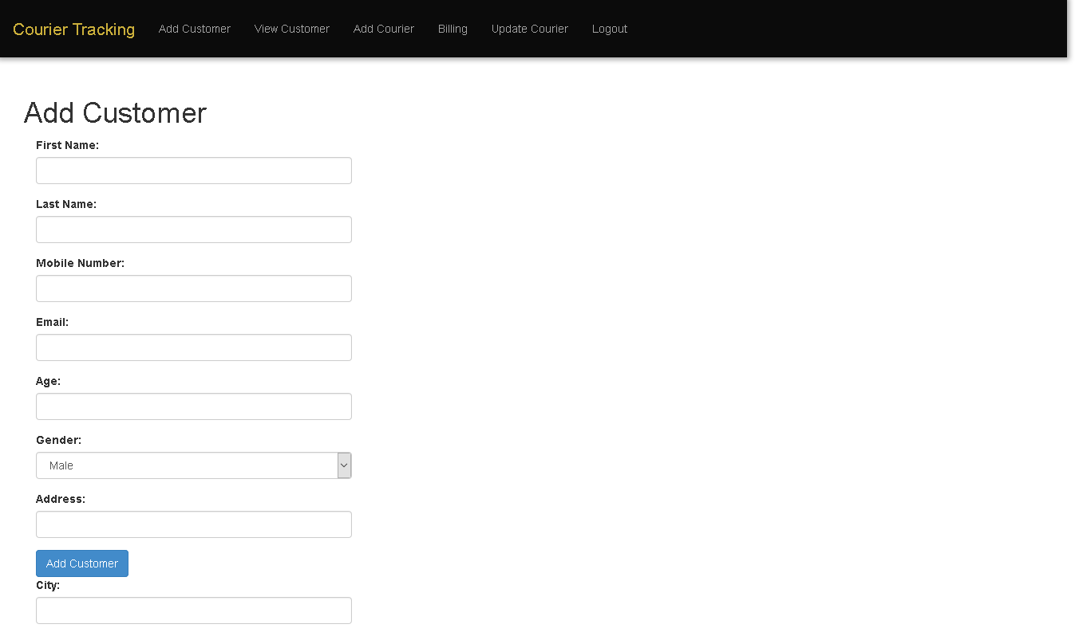

Slide 7
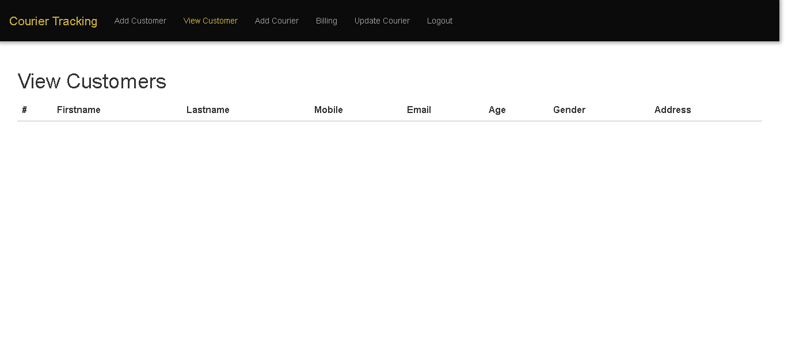

Slide 8
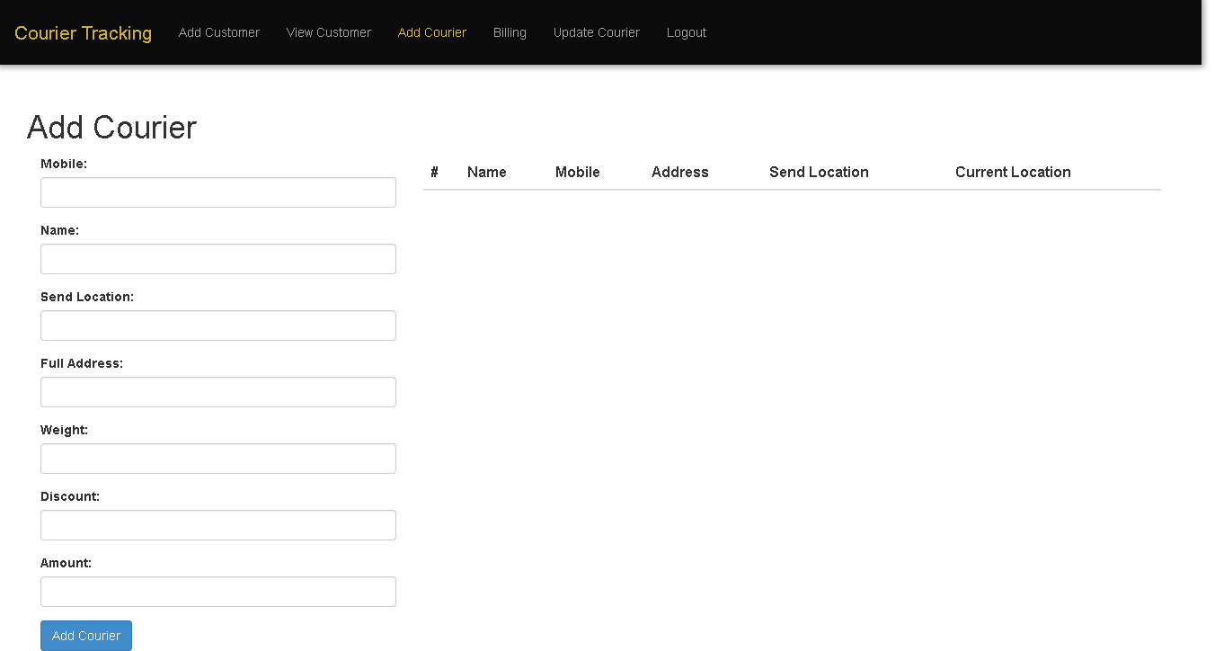

Slide 9
